Slide 1
Quality Seed Production and Varietal Improvement Program for Climate Change
Ministry of Agriculture and Irrigation
Yezin Agricultural University
Nyo Mar Htwe

Slide 2
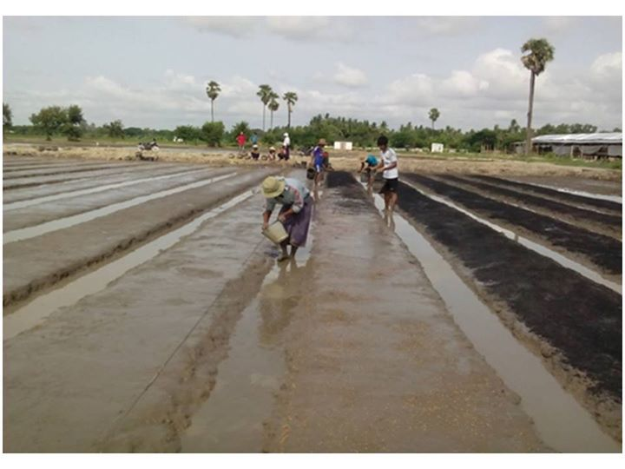
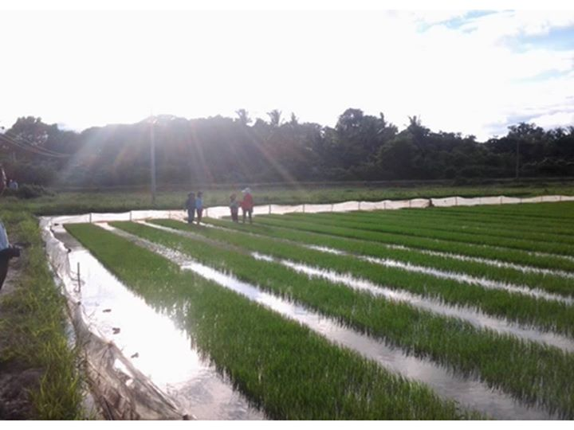
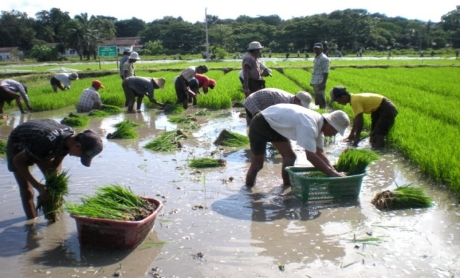
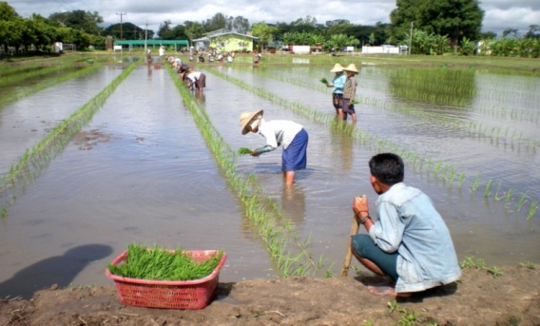
Seedbed preparation and Transplanting of R line
Hybrid Rice Seed Production Training to the Final Year B.Agr.Sc Students

Slide 3
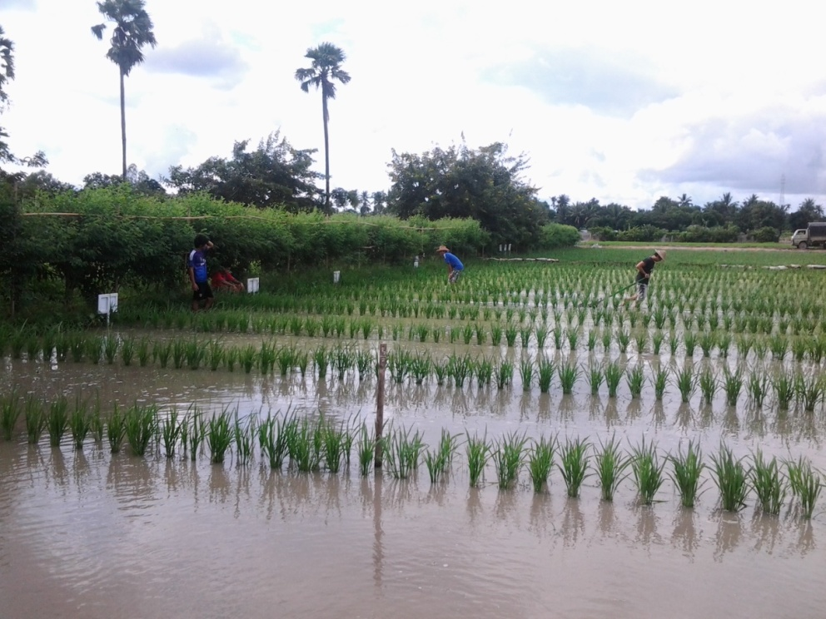
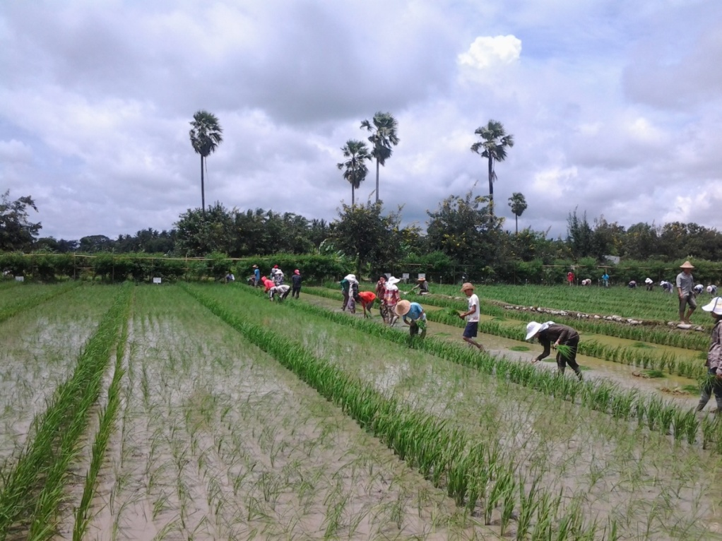
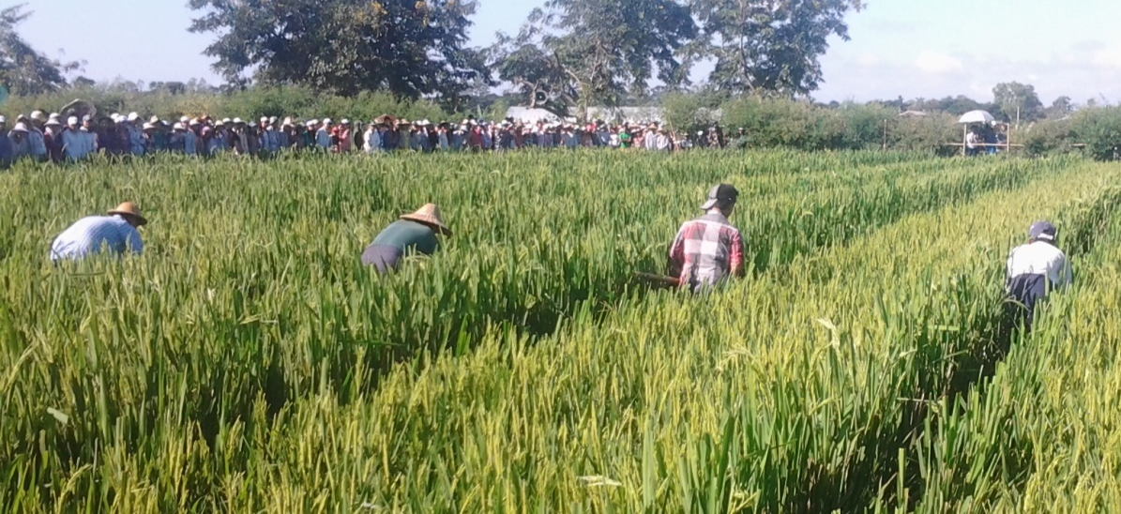
Wind break
Planting of A line
Supplementary pollination

Slide 4
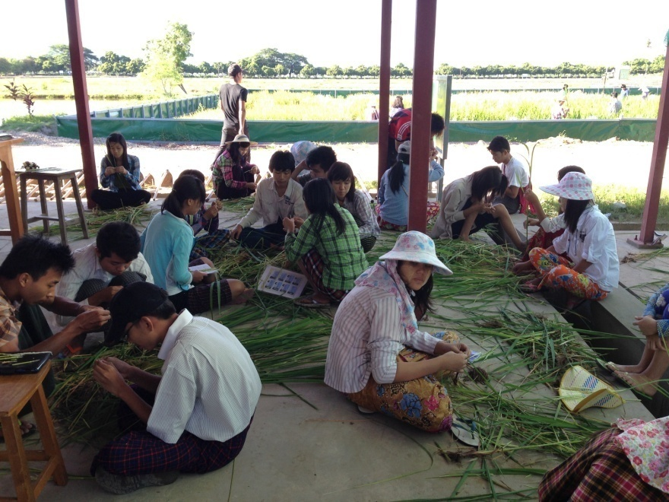
Studying the PI stages of Rice (2nd Year B.Agr.Sc Students)

Slide 5
Practicing the Production of Breeder Seeds (2nd Year B.Agr.Sc Student)

Slide 6
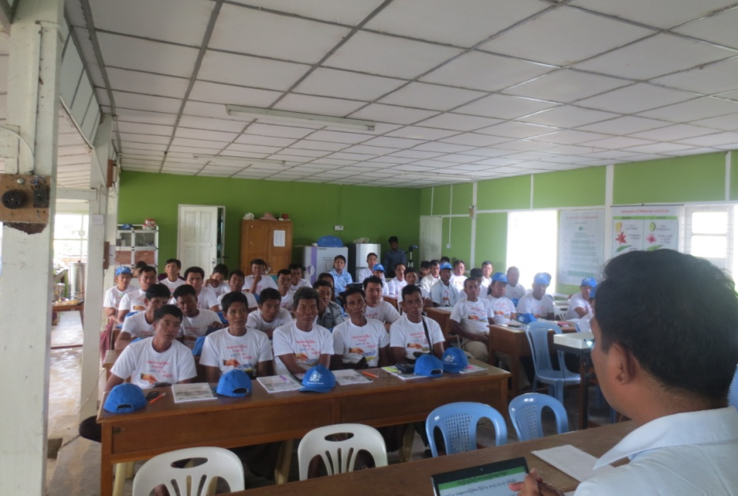
Quality Rice Seed Production Training (Farmers from Nay Pyi Taw, Bago, Mandalay)

Slide 7
Undergraduate Curriculum on Climate Change
Code | Course Name
AGY-4206 | Agrometerology
BPE-4101 | Plant Genetic Resources Conservation and Management
BPE-4201 | Molecular Plant Breeding
PBP-4204 | Stress Physiology
BPE-5101 | Crop Improvement for Climate Change
BPE-5102 | Environmental Plant Physiology
AEC-4201 | Introduction Course of Natural Resource Management and Environmental Economics

Slide 8
Postgraduate Curriculum on Climate Change
Code | Course Name
AGY-643 | Field Crop Physiology
AGY-711 | Agroecology
AGY-714 | Advanced Crop Physiology
BTY-721 | Plant Genetic Resources and Plant Breeding
AEC-650 | Principles of Natural Resources
AEC-651 | Environmental Resource Economics
AEC-715 | Advanced Natural Resource Management and Environmental Economics

Slide 9
Effect of Climate Change on Food Security
Temperature ↑ -> lead to heat stress for plants, sterility ↑and yield ↓, water ↑ requirements
Rainfall -> more unpredictable & unreliable (timing and amount), growing seasons are changing & eroding the value of traditional agricultural knowledge
pests & diseases outbreak

Slide 10
Activities on Production of Pureline
Parental Lines -
Sinthu Kha, SinThwe Latt, Yadanar Toe, Shwe Thwe Yin, Long 6, Long 8
2012
Selected F₁ Hybrid
Sinthu Kha/ Long 6, Sinthu Kha/ Long 8, SinThwe Latt/ Long 6, SinThwe Latt /Yadanar Toe, SinThwe Latt /Sinthu Kha, Yadanar Toe/Long 6,
Long 8/Shwe Thwe Yin, Long 6/Shwe Thwe Yin
2013
2013
F₂
2014
F₃
Three selection method
Pedigree
Single Seed Decent
Bulk Population
2014
F₄
2015
F₅
2015
F₆
2016
F₇

Slide 11
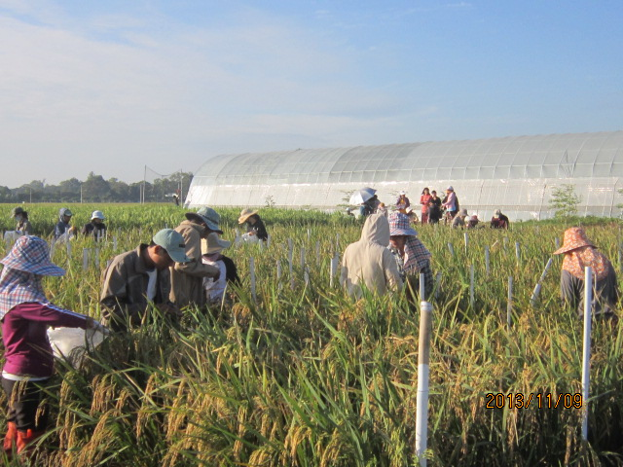
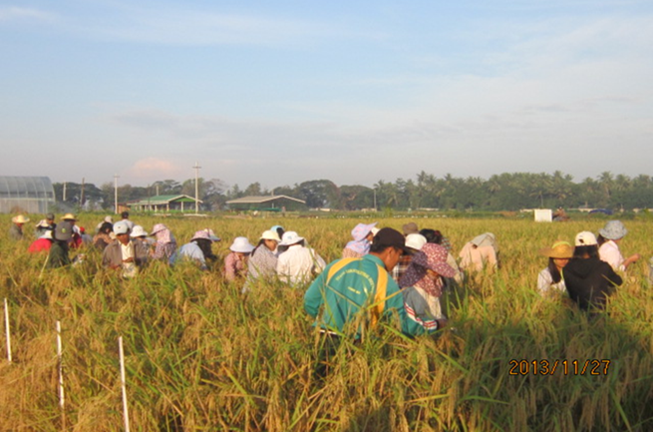
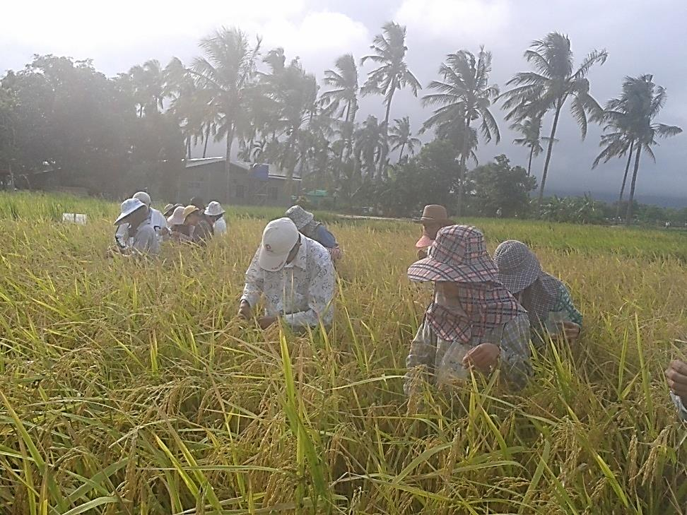
Selection of Early Maturing Rice varieties from segregating lines (For less water availability)
Selection Started from F₂ to F₇ Generation

Slide 12
Cooperation with IRRI – LIFT GEM Farmer Participatory Varietal Selection in Rice

Slide 13
Cooperation with JIRCAS
Rice varietal adaptation on high temperature (Heat tolerance rice varieties)
Screening for early morning flowering in rice (To escape Heat)

Slide 14
Types of anther discence
Field Survey on Spikelet Sterility Under Heat Stress in Rice Varieties
Few pollen grains on stigma cause sterility
Number of germinated pollens on stigma
Many pollen grains on stigma cause spikelet fertility

Slide 15
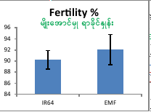
Flower opening time between IR64 and IR64-EMF
Evaluation of Early Morning Flowering Character in Near Isogenic Line and their Recurrent Parent
Germplasm evaluation of Myanmar rice cultivars for EMF
Source: Ishimaru

Slide 16
Future program
Preparation to summit to the Technical Seed Committee
IR64-EMF lines from IRRI-JIRCAS will be tested in 2017 (DS) at 3 locations & release in 2018
2 pure-line derived from 3 methods of selection in 2017 at 3 locations & release in 2018

Slide 17
Way Forward
A diversity of climate smart crop varieties in vulnerable areas (biotic and abiotic tolerant varieties)
Hybrid for commercial production areas
Inbred for remote areas
Crop insurance program should be formulated

Slide 18
Thank You!

Slide 19
Curriculum for Seed Production
Code | Course Name
AGY -4103 | Principles of Seed Technology
AGY-4104 | Principle of Postharvest Technology
BPE-4102 | Methods of Plant Breeding
HSC-4115 | Seed Production of Horticultural Crops

